Slide 1
Diagnostic Techniques and Solutions for Violations
Regression Analysis and Non-Linear Models: Sociology 6100

Slide 2
Specification Error
Measurement Error
Multicollinearity
Heteroscedasticity

Slide 3

Specification Errors
Irrelevant IVs are included
Diagnostic Signals
Large R²
$H_{0}$: β =0 is not rejected
Large SE for Beta
Solutions
Theoretically reexamine the model (equation)
Delete theoretically irrelevant IV’s
Model Summary (b)
a Predictors: (Constant), Age of Respondent, Respondent's Sex, Highest Year of School Completed, Labor
Model | R | R Square | Adjusted R Square | Std. Error of the Estimate | Durbin-Watson
1 | .620(a) | .384 | .381 | 4.228 | 1.747

Slide 4
Specification Errors (cont.)
ANOVA(b)
a Predictors: (Constant), Age of Respondent, Respondent's Sex, Highest Year of School Completed, Labor Force Status
b Dependent Variable: Respondent's Income
Coefficients(a)
Model |  | Sum of Squares | df | Mean Square | F | Sig.
1 | Regression | 9519.009 | 4 | 2379.752 | 133.114 | .000(a)
 | Residual | 15267.433 | 854 | 17.878
 | Total | 24786.442 | 858
Model |  | Unstandardized Coefficients |  | Standardized Coefficients | t | Sig.
 |  | B | Std. Error | Beta
1 | (Constant) | 11.129 | 1.134 |  | 9.814 | .000
 | Highest Year of School Completed | .544 | .053 | .281 | 10.310 | .000
 | Labor Force Status | -6.089 | .400 | -.422 | -15.222 | .000
 | Respondent's Sex | -1.684 | .295 | -.157 | -5.706 | .000
 | Age of Respondent | .105 | .012 | .235 | 8.684 | .000

Slide 5
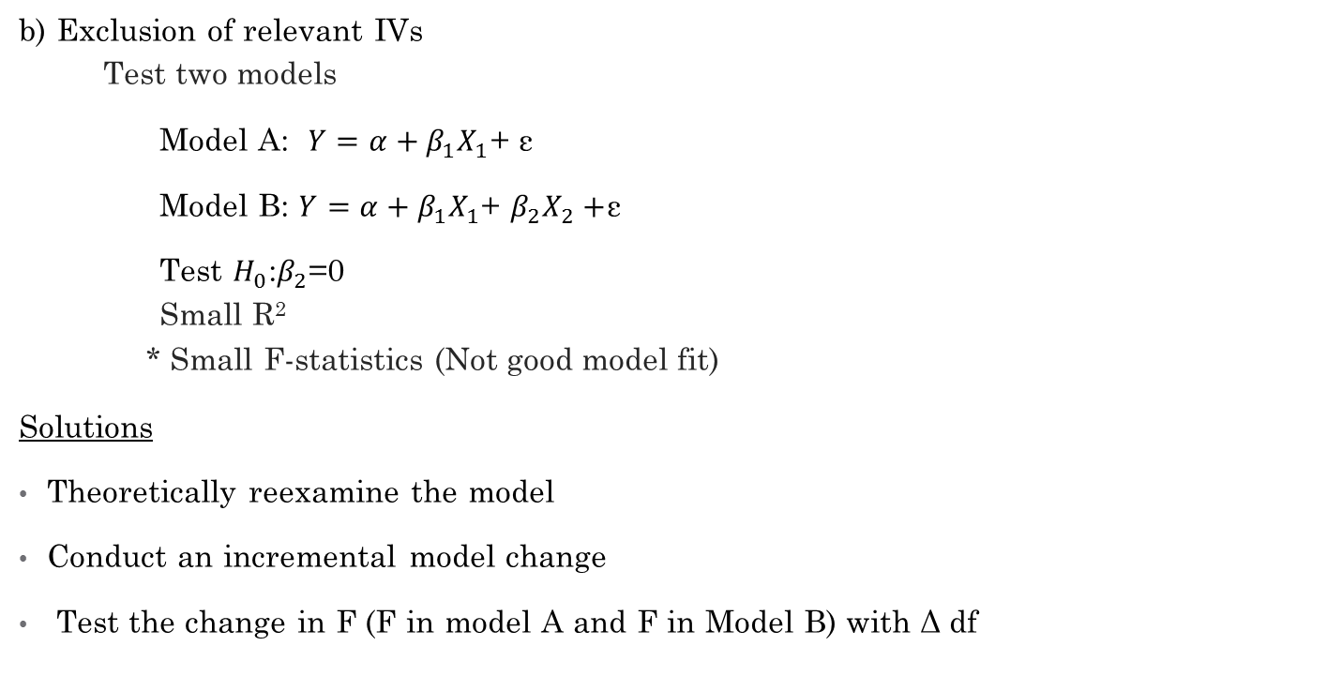
Specification Errors (cont.)
b) Exclusion of relevant IVs
Test two models
Model A: $Y=α+β_{1}X_{1}$+ ε
Model B: $Y=α+β_{1}X_{1}$+ $β_{2}X_{2}+$ε
Test $H_{0}$:$β_{2}$=0
Small R²
* Small F-statistics (Not good model fit)
Solutions
Theoretically reexamine the model
Conduct an incremental model change
Test the change in F (F in model A and F in Model B) with Δ df

Slide 6
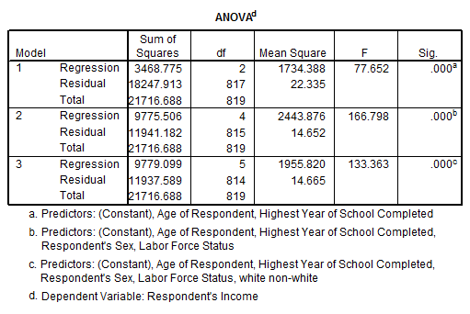
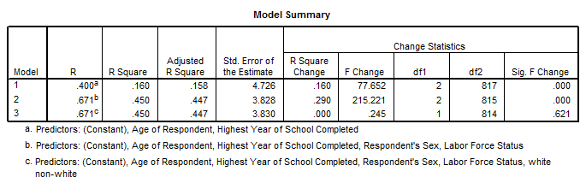
Specification Errors (cont.)

Slide 7
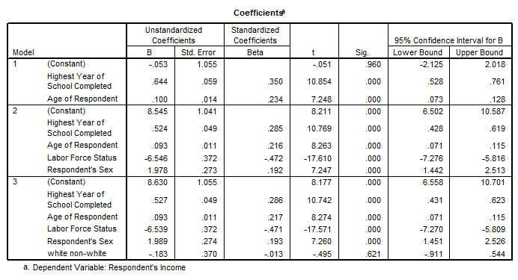
Specification Errors (cont.)

Slide 8
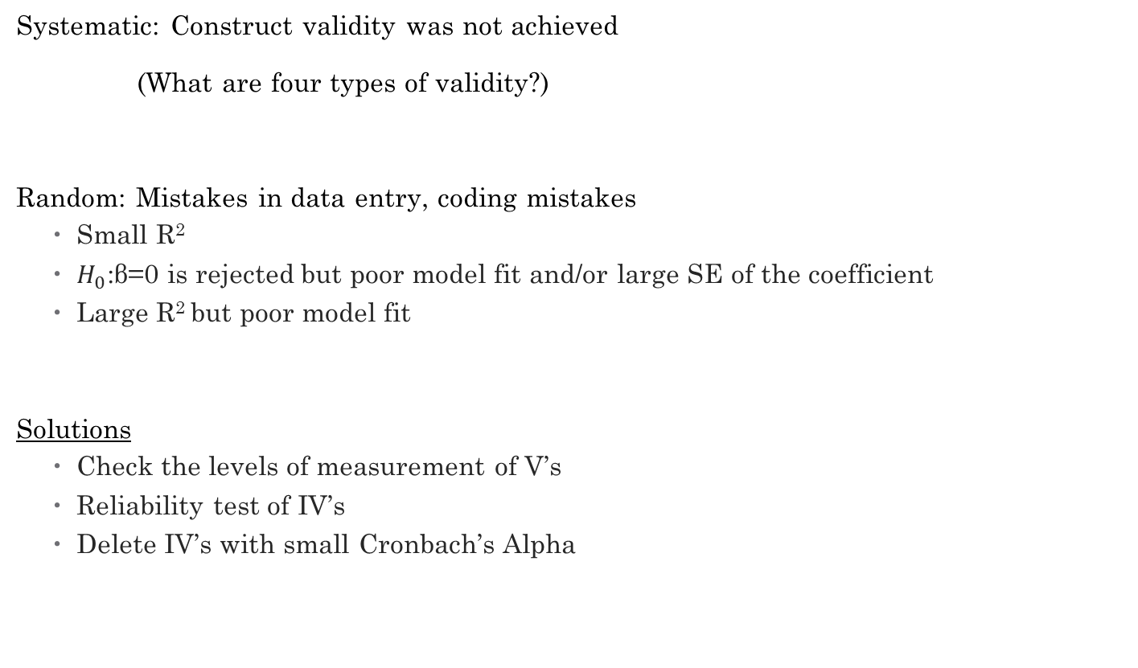
Measurement Errors
Systematic: Construct validity was not achieved
(What are four types of validity?)
Random: Mistakes in data entry, coding mistakes
Small R²
$H_{0}$:β=0 is rejected but poor model fit and/or large SE of the coefficient
Large R² but poor model fit
Solutions
Check the levels of measurement of V’s
Reliability test of IV’s
Delete IV’s with small Cronbach’s Alpha

Slide 9
e.g. Psychological Well-being (The eight Items came from Ryff's Scales of Psychological Well-Being (RPWB)
 | Strongly Disagree | Disagree | Neutral | Agree | Strongly Agree
F1. I tend to be influenced by people with strong opinions. | □ | □ | □ | □ | □
F2. I have confidence in my opinions, even if they are contrary to the general consensus. | □ | □ | □ | □ | □
F3. I tend to worry about what other people think of me. | □ | □ | □ | □ | □
F4. I judge myself by what I think is important, not by the values of what others think is important. | □ | □ | □ | □ | □
F5. When I look at the story of my life, I am pleased with how things have turned out. | □ | □ | □ | □ | □
F6. In general, I feel confident and positive about myself. | □ | □ | □ | □ | □
F7. I like most parts of my personality. | □ | □ | □ | □ | □
F8. In many ways I feel disappointed about my achievements in life. | □ | □ | □ | □ | □

Slide 10
Multicollinearity
Some IVs are strongly correlated with each other
Multicollinearity is a matter of degree
# of IV’s > # of cases (n)
Large F but some IV’s are not significant
Large CI for β’s
Extremely large R² but cannot achieve good model fit
Small tolerance
Large Variance Inflation Factor (VIF)
Model Summary
Model | R | R Square | Adjusted R Square | Std. Error of the Estimate
1 | .385ª | .148 | .146 | 51415.980
a. Predictors: (Constant), HIGHEST YEAR OF SCHOOL COMPLETED, AGE OF RESPONDENT, RS HIGHEST DEGREE

Slide 11
Multicollinearity (cont.)

Slide 12
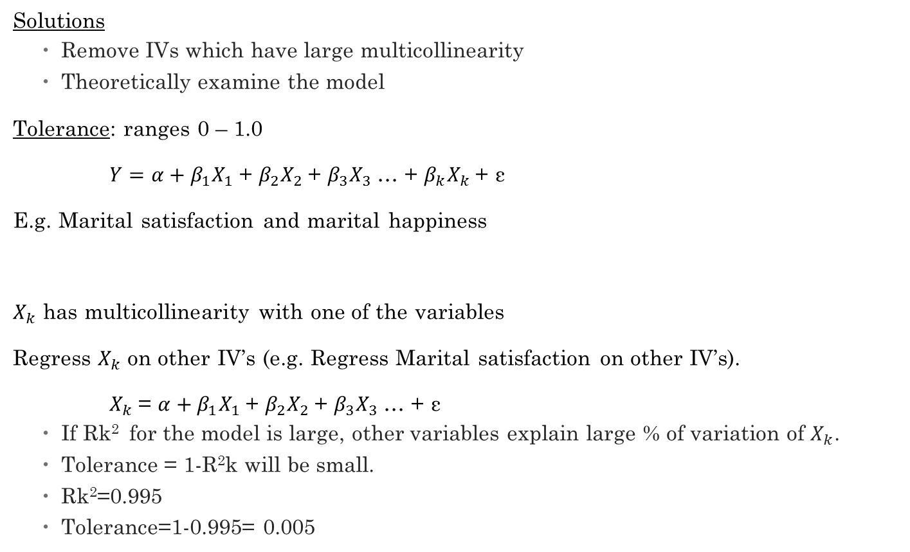
Multicollinearity (cont.)
Solutions
Remove IVs which have large multicollinearity
Theoretically examine the model
Tolerance: ranges 0 – 1.0
$Y=α+β_{1}X_{1}$+ $β_{2}X_{2}$+ $β_{3}X_{3}$… + $β_{k}X_{k}$+ ε
E.g. Marital satisfaction and marital happiness
$X_{k}$ has multicollinearity with one of the variables
Regress $X_{k}$ on other IV’s (e.g. Regress Marital satisfaction on other IV’s).
$X_{k}$= $α+β_{1}X_{1}$+ $β_{2}X_{2}$+ $β_{3}X_{3}$… + ε
If Rk² for the model is large, other variables explain large % of variation of $X_{k}$.
Tolerance = 1-R²k will be small.
Rk²=0.995
Tolerance=1-0.995= 0.005

Slide 13
Multicollinearity (cont.)
VIF (inverse of tolerance)
VIF=1/(1-Rk²⁾
E.g. When Highest year of school complete is used as DV

Slide 14
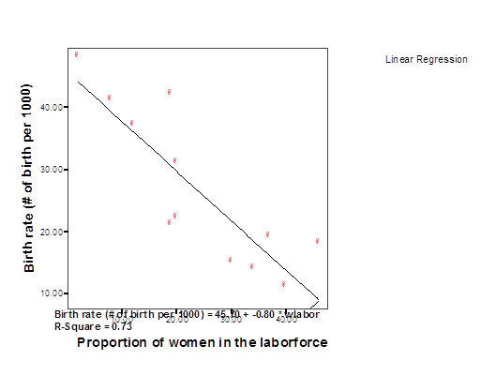
Outliers and Heteroscedasticity
Errors are not correlated with each other
Errors (residuals) are normally distributed
Check scatter diagram of DV and major IV

Slide 15
Outliers and Heteroscedasticity (cont.)
Case wise residuals
Casewise Diagnostics(a)
a Dependent Variable: Respondent's Income
Case Number | Std. Residual | Respondent's Income | Predicted Value | Residual
4 | 3.195 | 22 | 8.49 | 13.507
91 | 3.352 | 22 | 7.83 | 14.174
108 | 3.805 | 22 | 5.91 | 16.089
136 | 3.448 | 22 | 7.42 | 14.578
148 | 3.111 | 22 | 8.84 | 13.156
226 | 3.253 | 22 | 8.25 | 13.753
247 | 3.244 | 22 | 8.28 | 13.718
689 | 3.549 | 20 | 5.00 | 15.004
853 | -3.466 | 4 | 18.65 | -14.655
1063 | -3.033 | 1 | 13.82 | -12.825

Slide 16
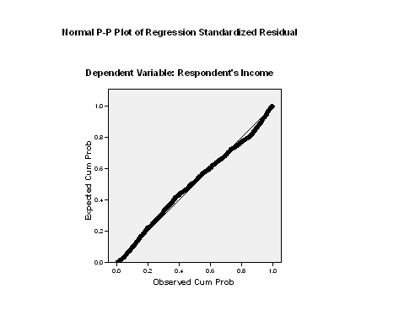
Outliers and Heteroscedasticity (cont.)
Normal Probability Plot (P-P)

Slide 17
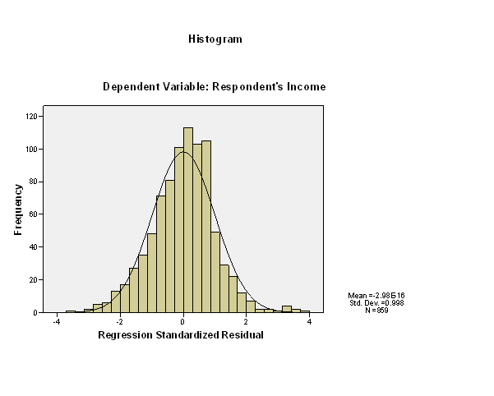
Outliers and Heteroscedasticity (cont.)
Histogram of Standardized residuals (ZRESD)

Slide 18
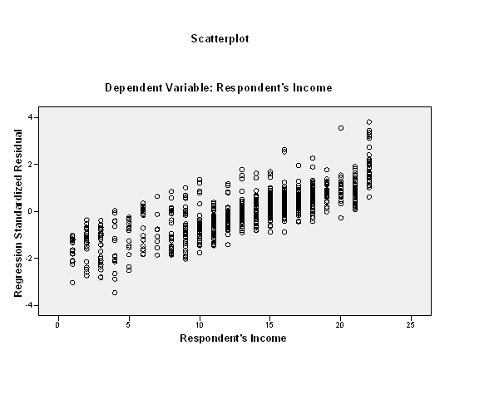
Outliers and Heteroscedasticity (cont.)
Scatter diagram of ZResiduals

Slide 19
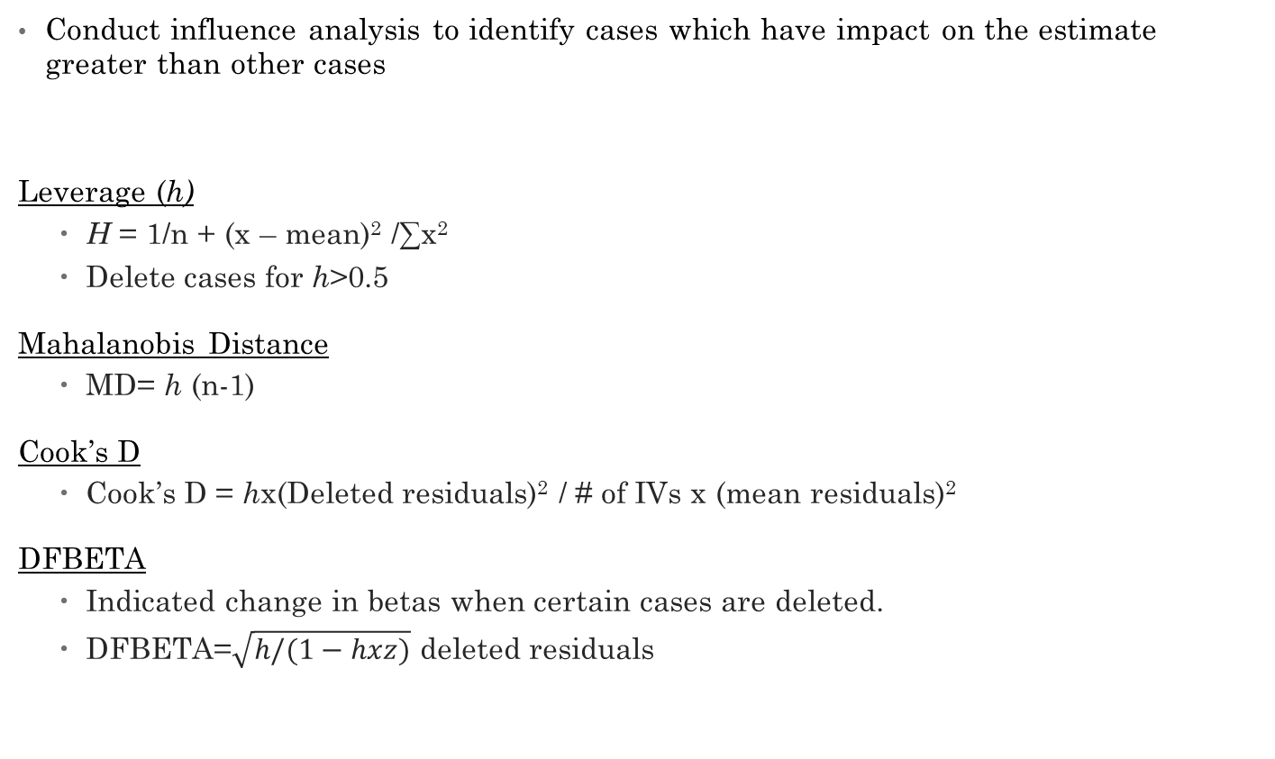
Outliers and Heteroscedasticity (cont.)
Conduct influence analysis to identify cases which have impact on the estimate greater than other cases
Leverage (h)
H = 1/n + (x – mean)² /∑x²
Delete cases for h>0.5
Mahalanobis Distance
MD= h (n-1)
Cook’s D
Cook’s D = hx(Deleted residuals)² / # of IVs x (mean residuals)²
DFBETA
Indicated change in betas when certain cases are deleted.
DFBETA=$\sqrt{h/(1−hxz)}$ deleted residuals

Slide 20
Outliers and Heteroscedasticity (cont.)
Solutions
If outliers < 5-10% of the sample delete them (how large is the sample?) by case wise diagnostic
Delete IVs which have heteroscedasticity
Transformation of IV which does not have linear relationship with DV
Delete cases by Influence analysis

Slide 21
Questions!

